Slide 1
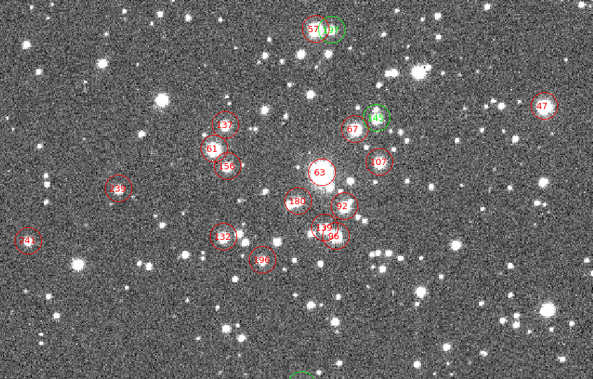
The Stellar Content of IC1320(Berkeley 50)
By Meghan Speckert
Under the mentorship of Dr. Phil Massey

Slide 2
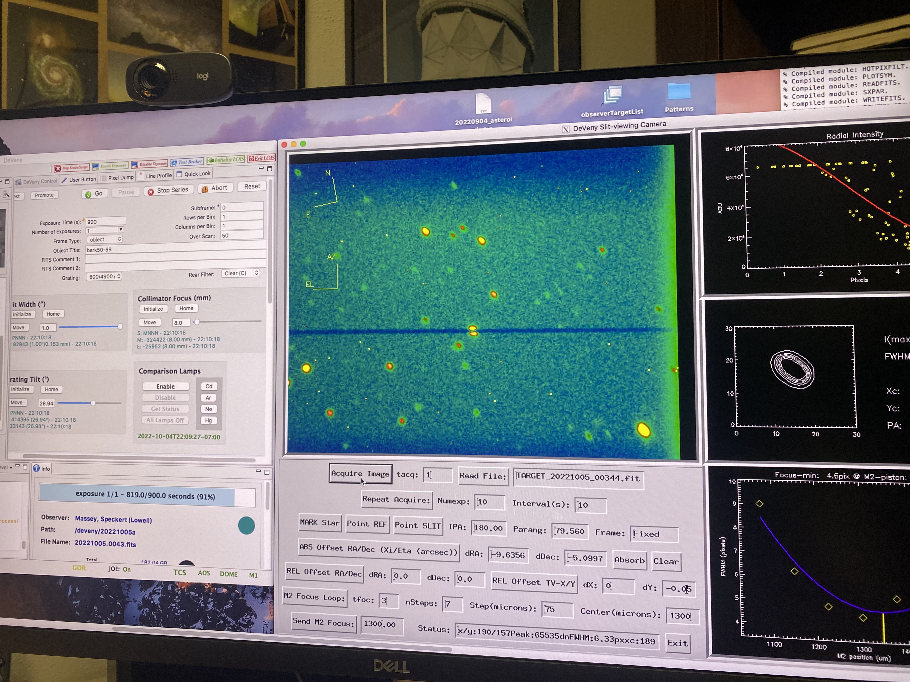
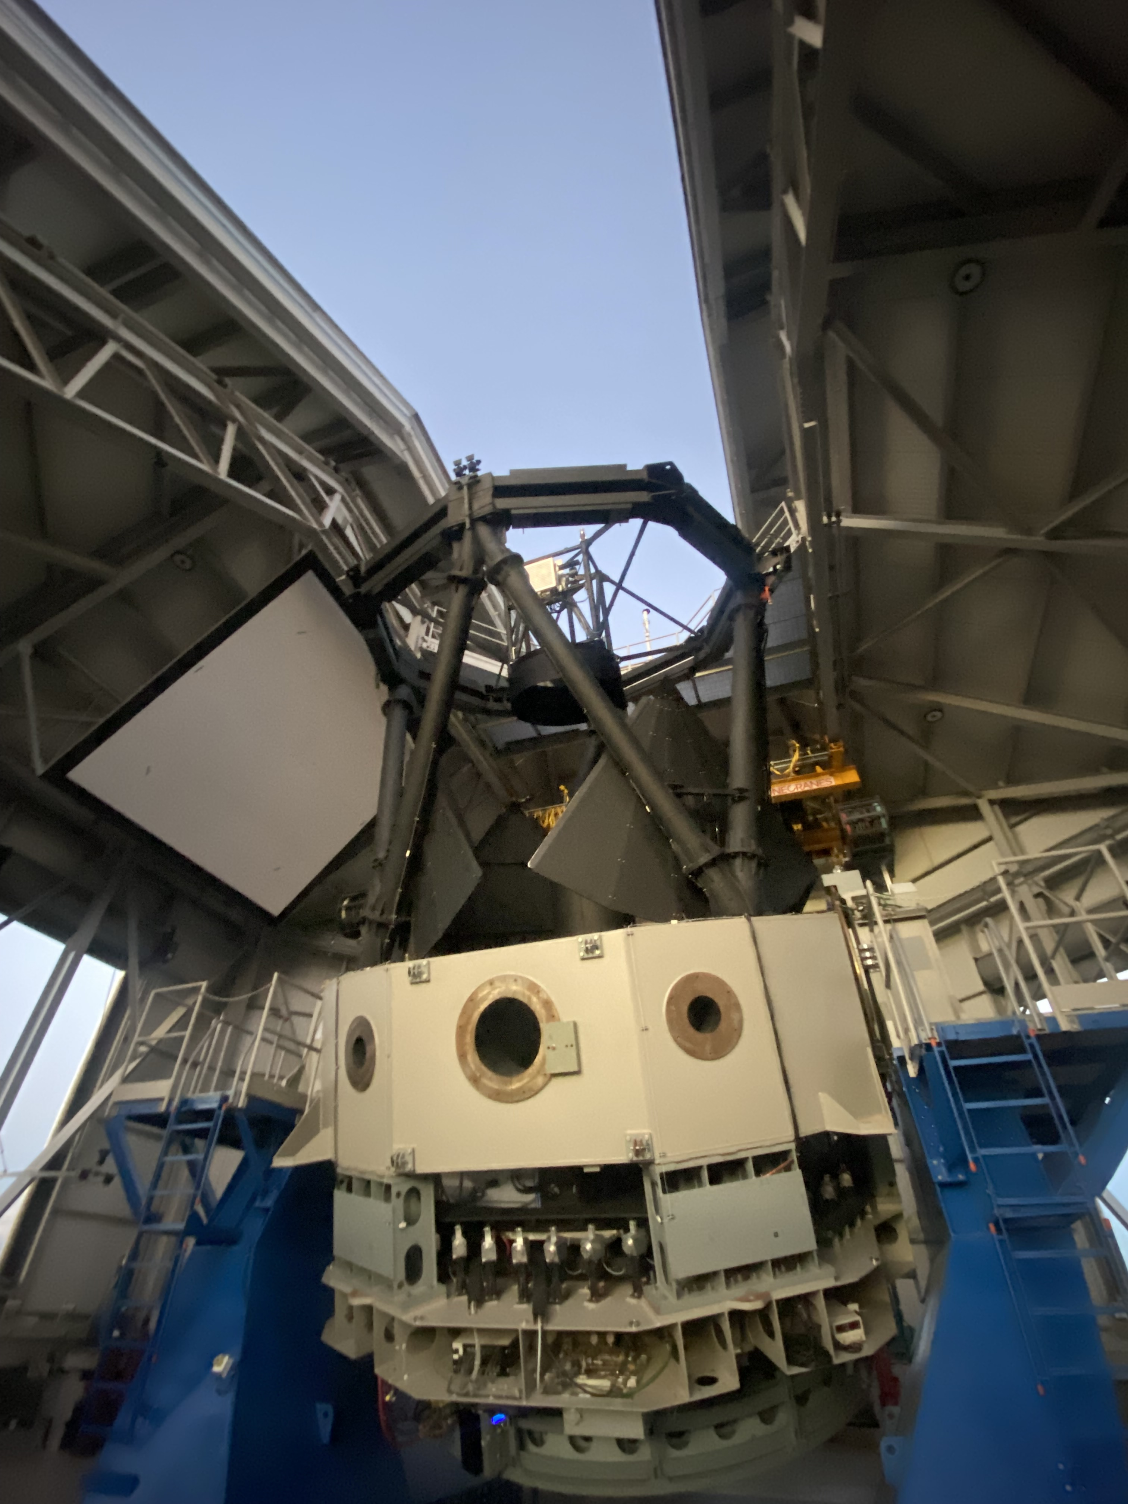
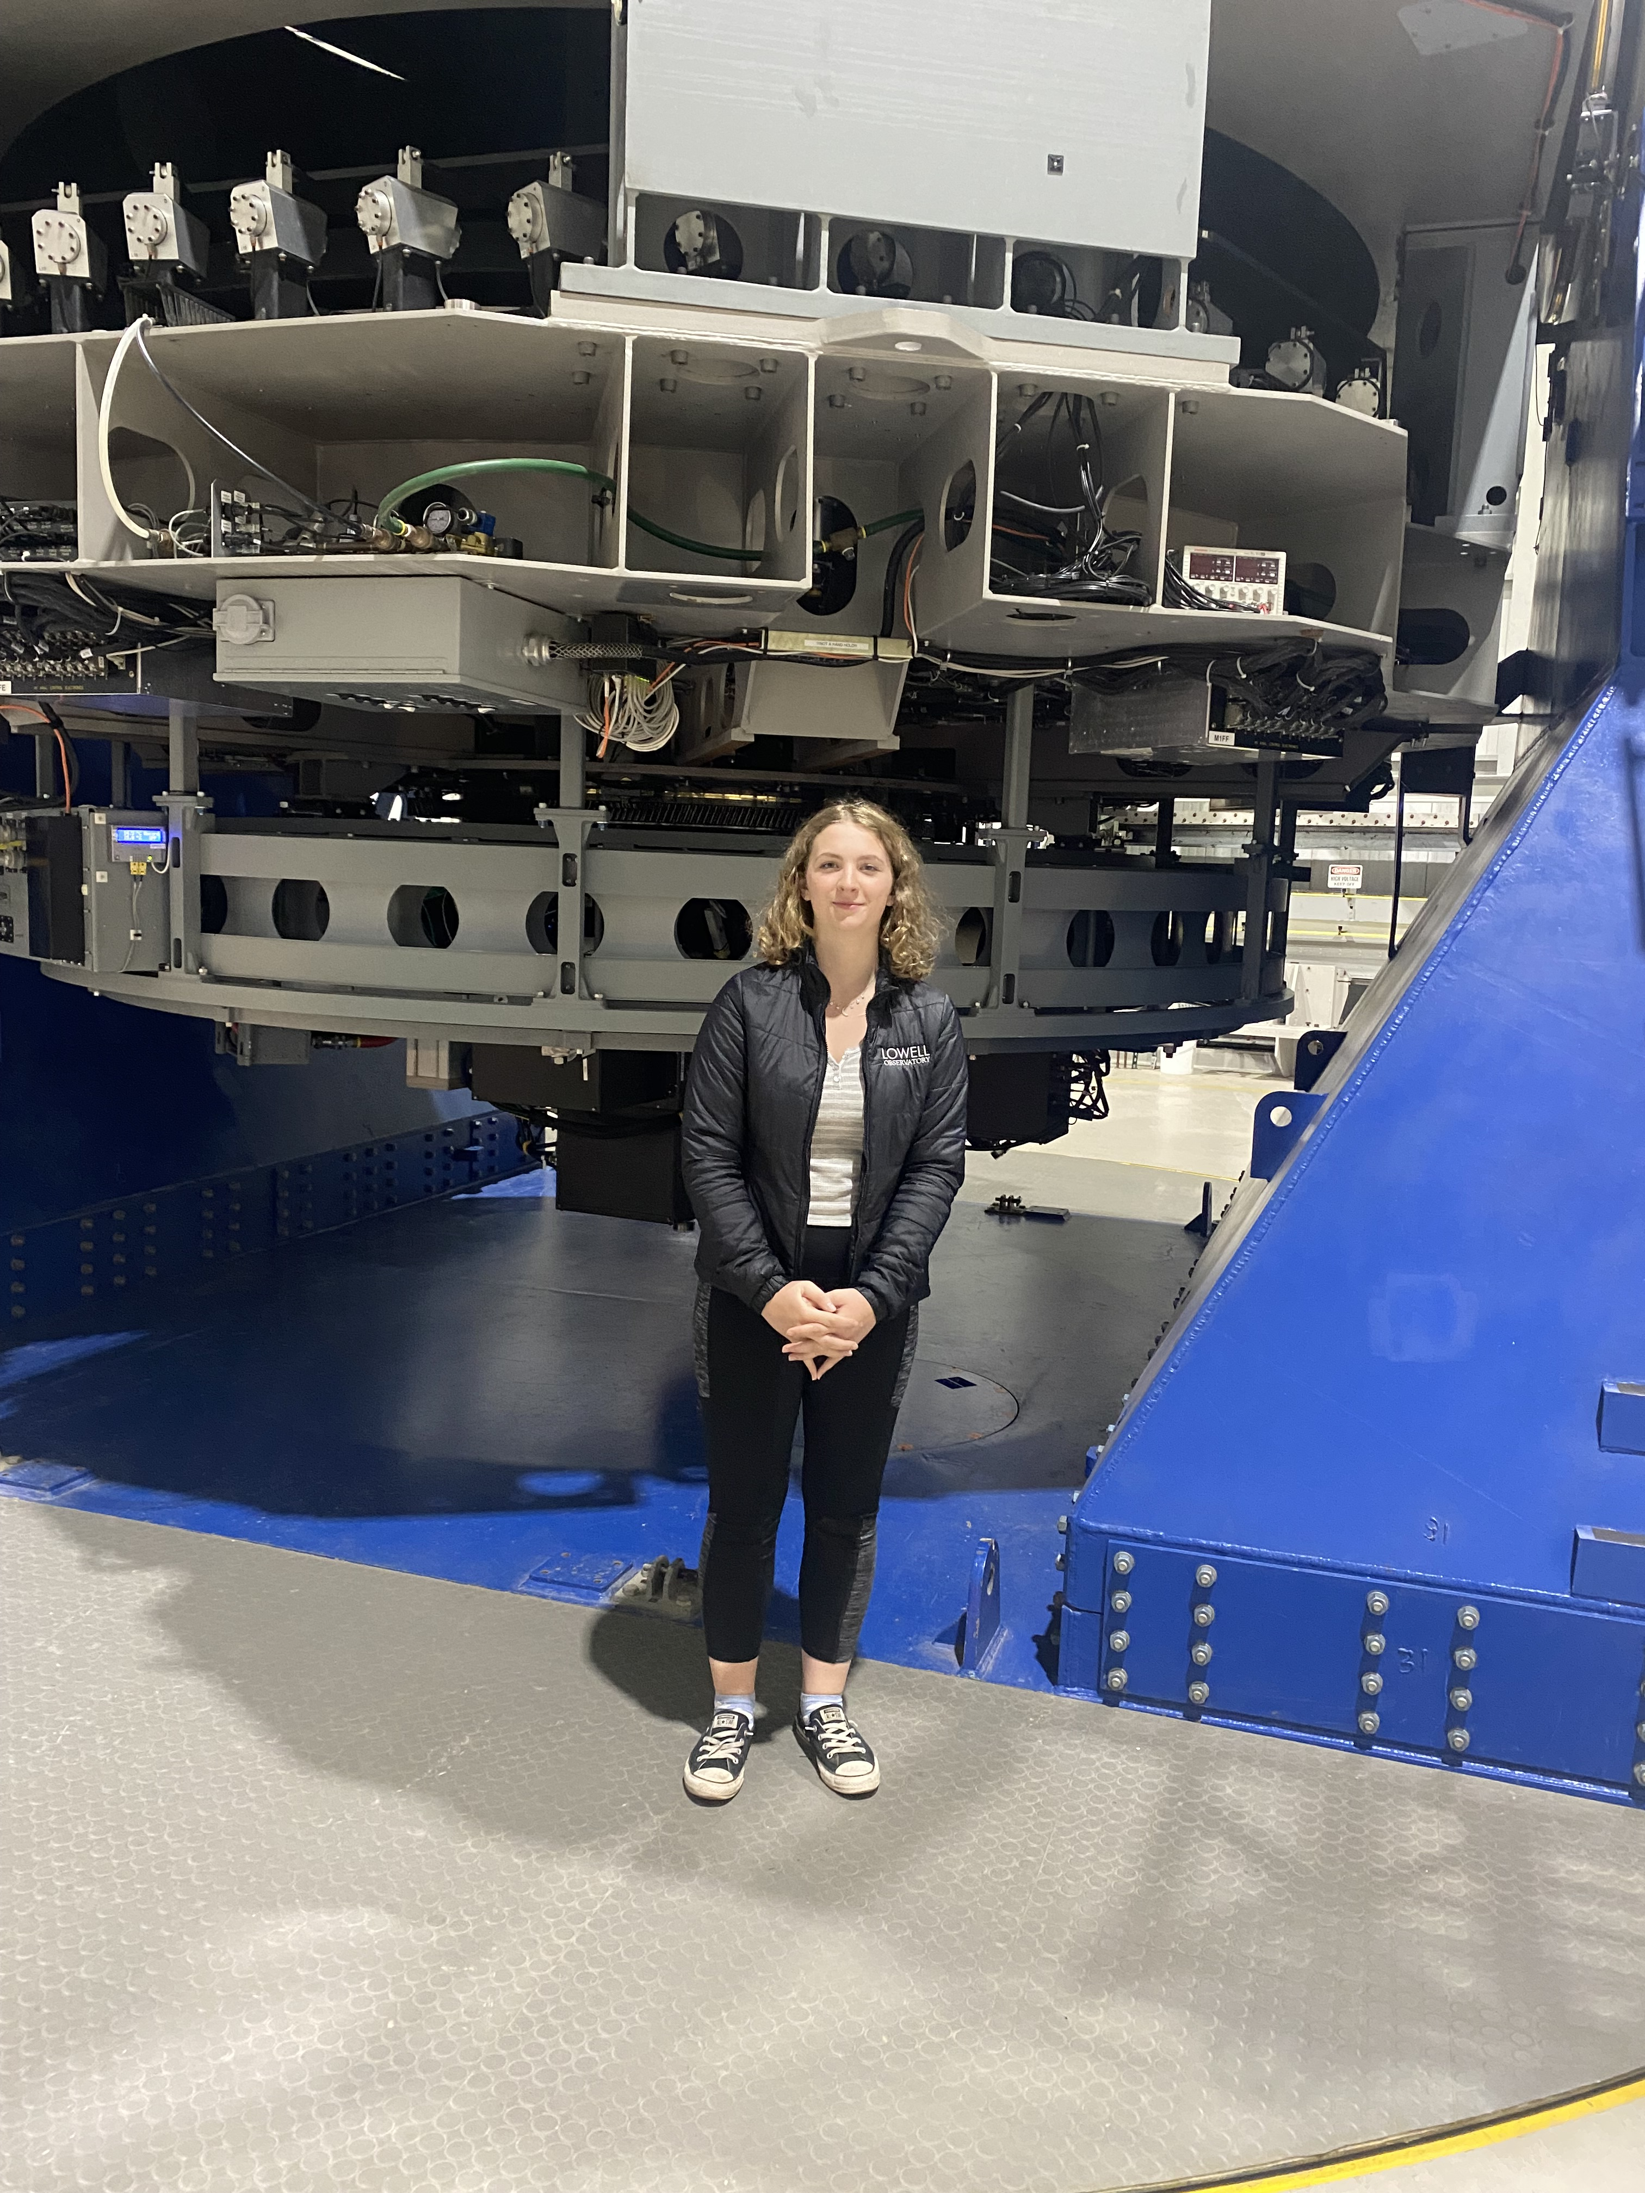
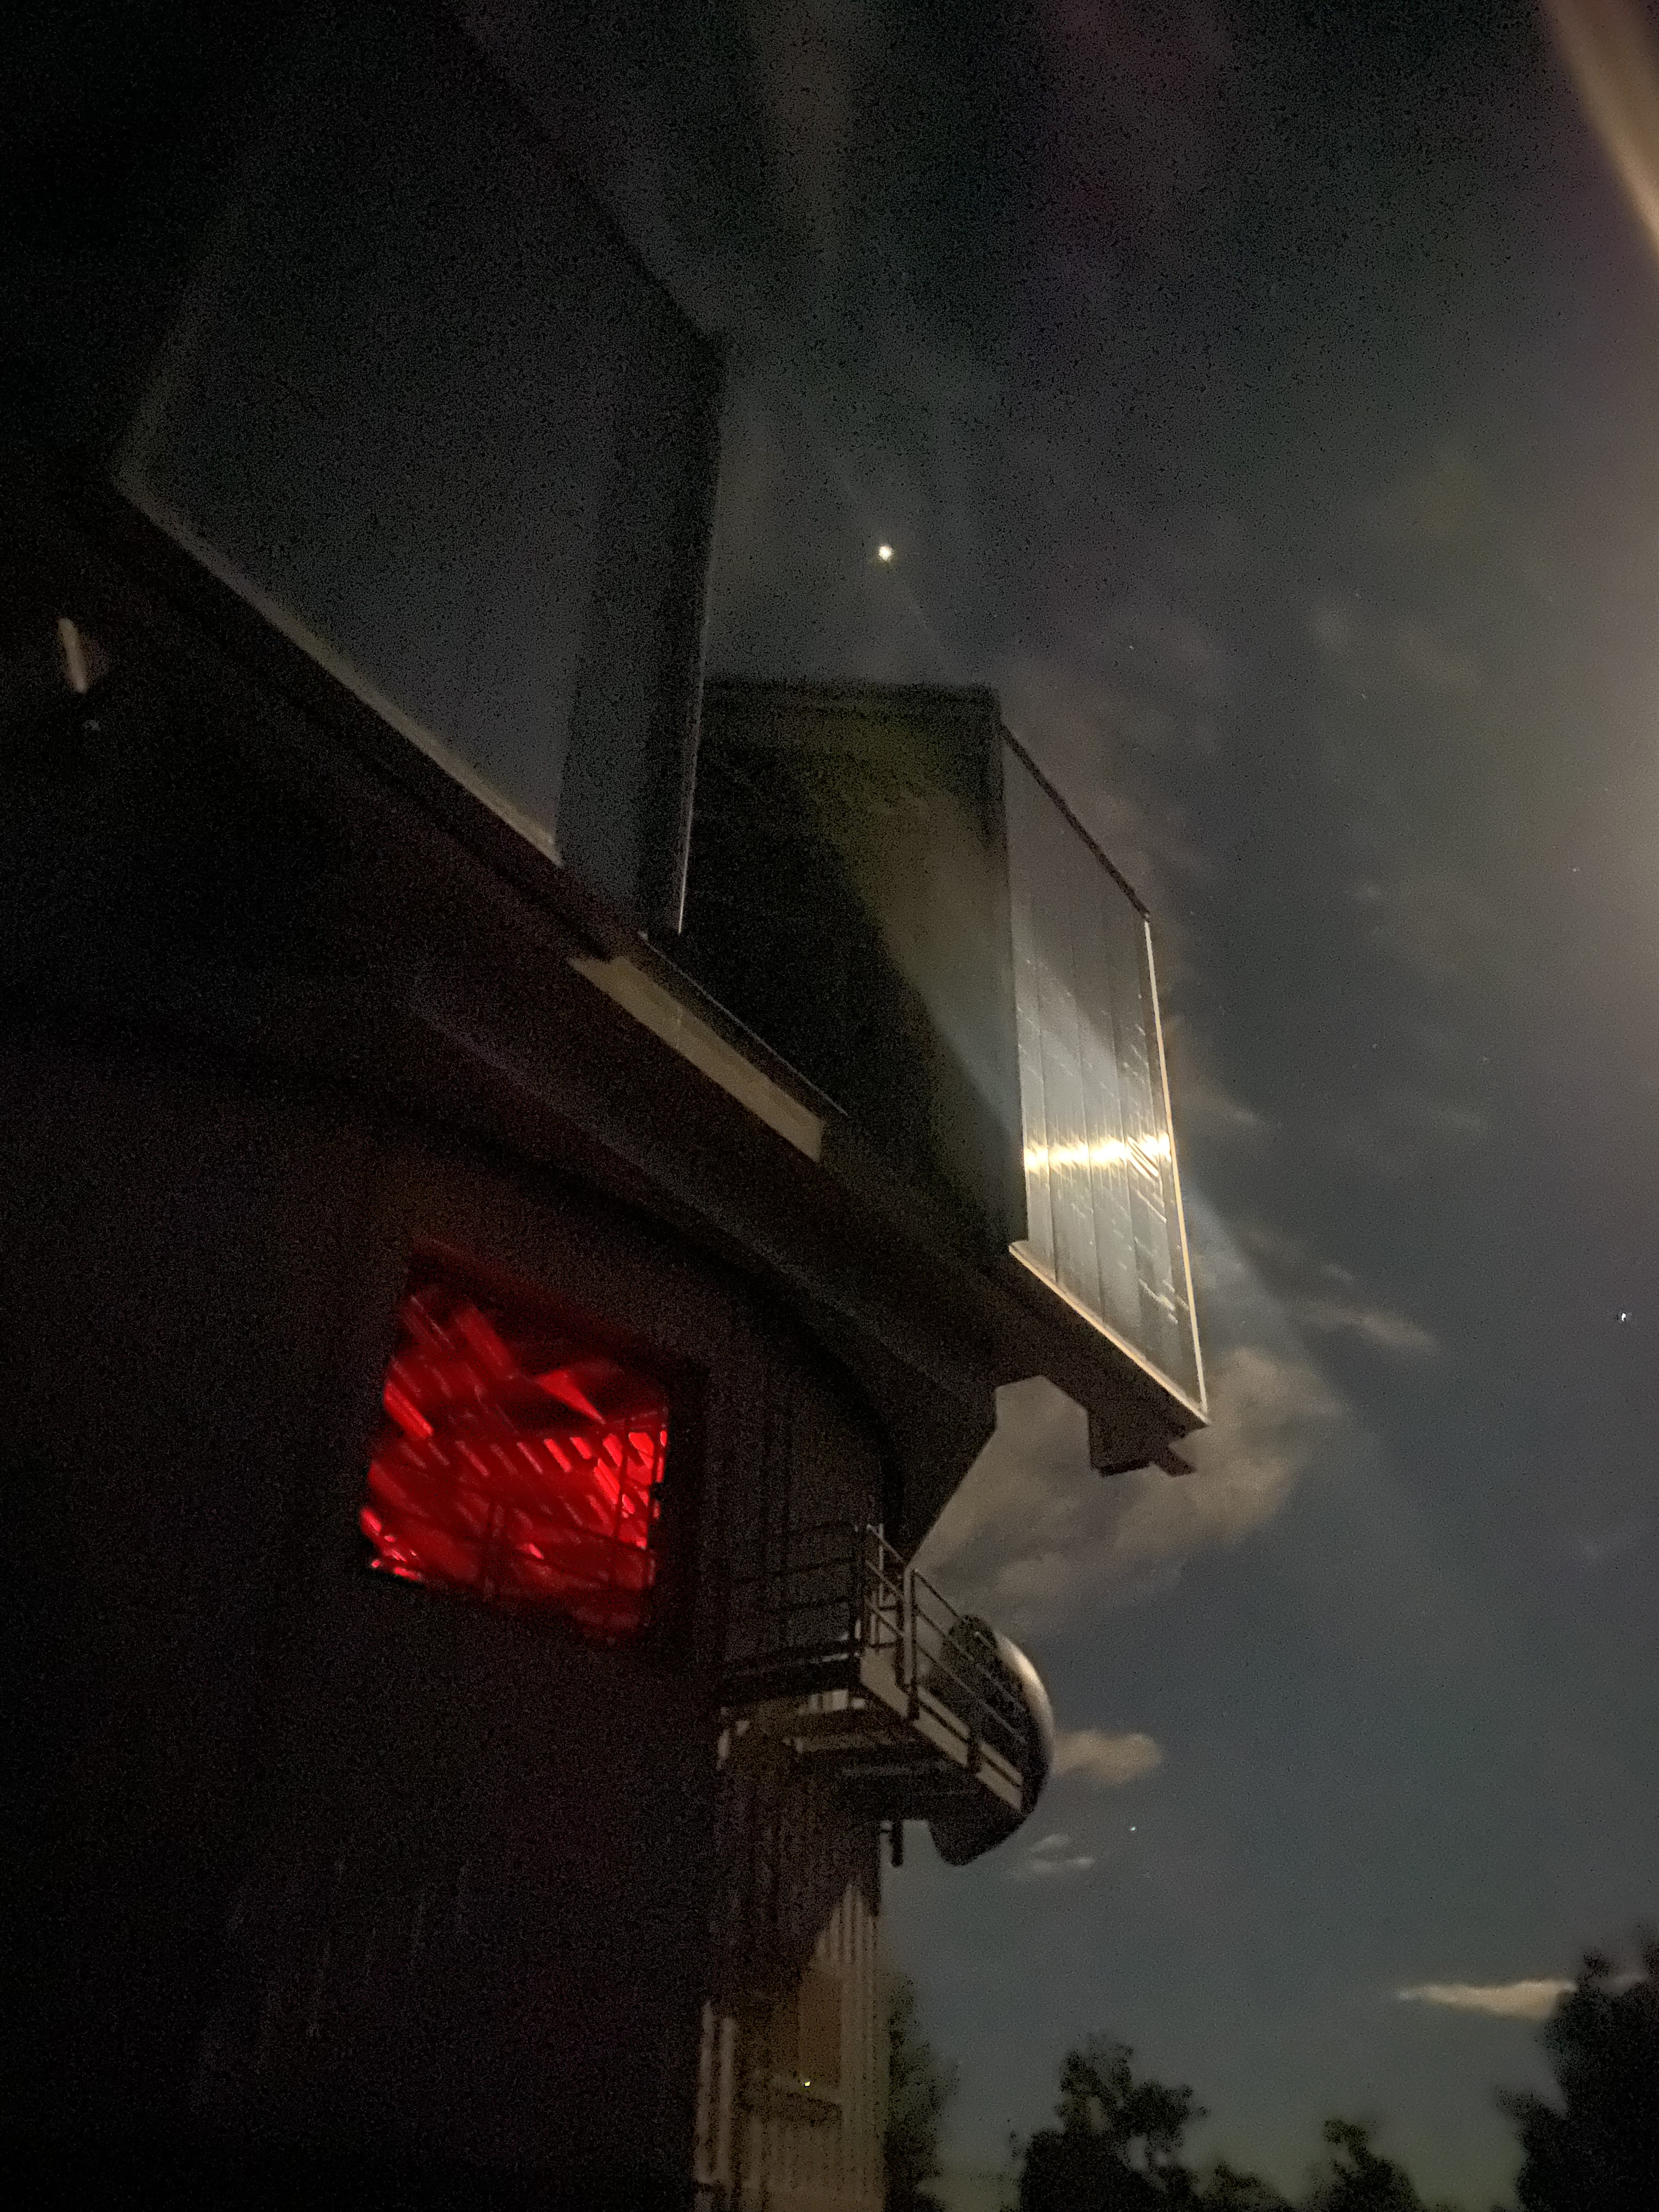
Collecting Data

Slide 3
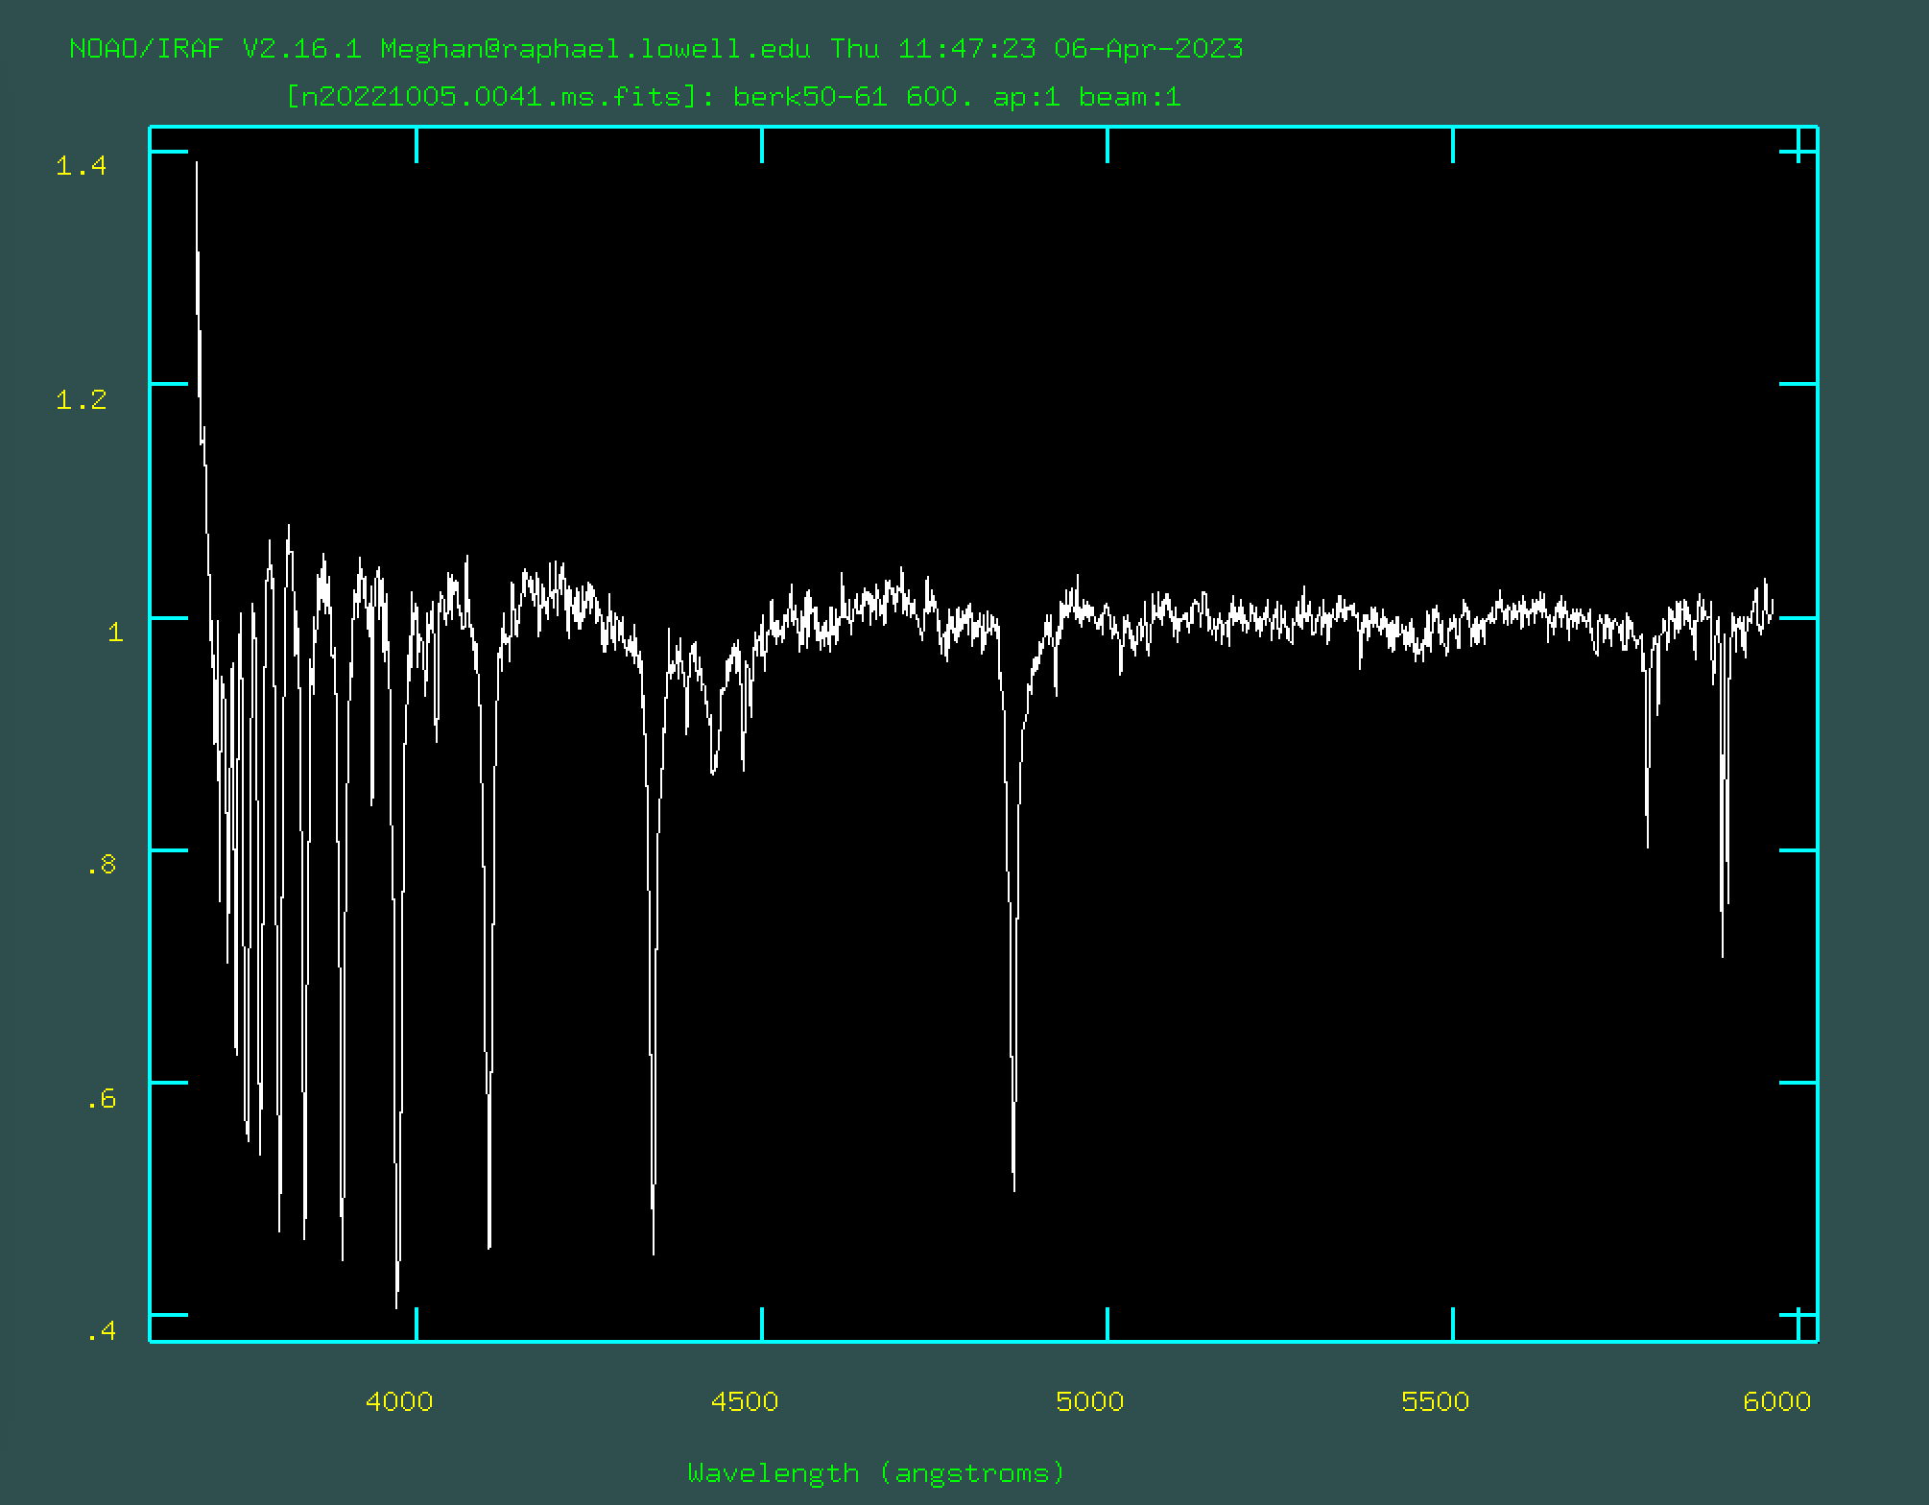
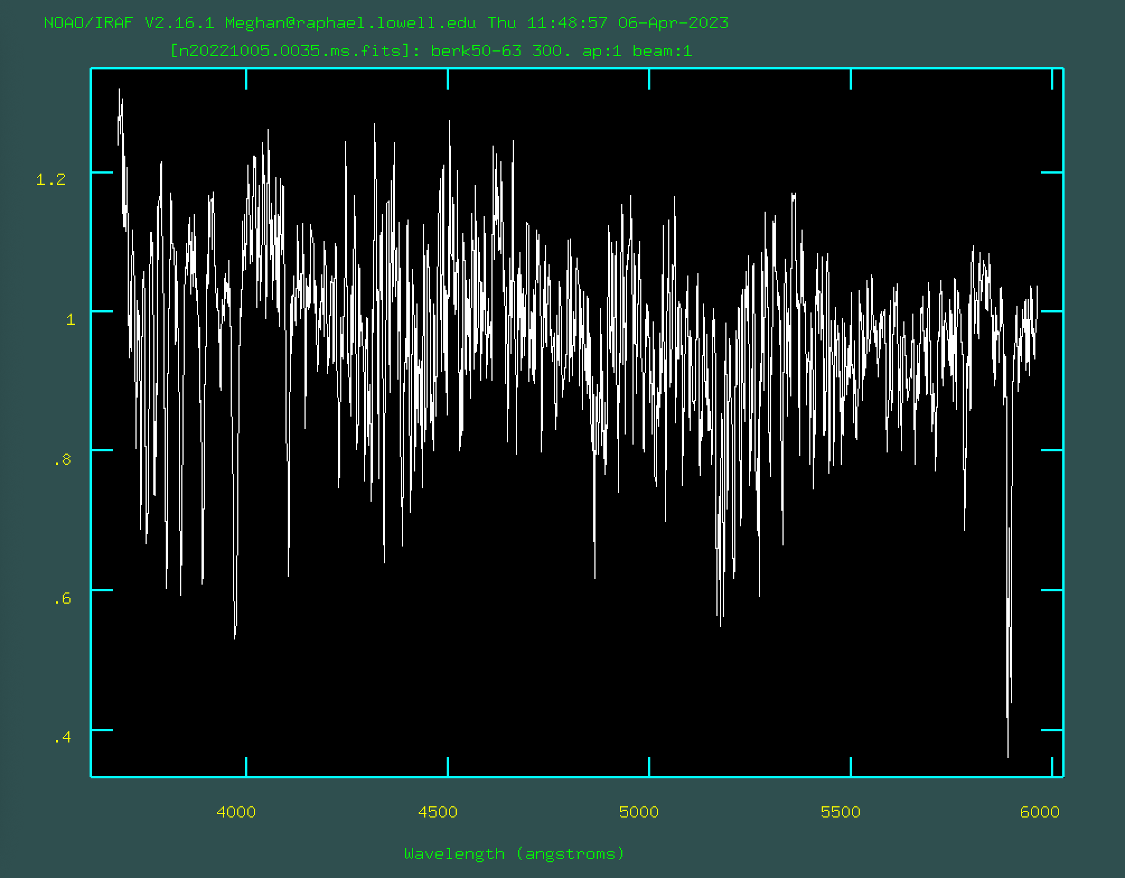
Classifying the Spectra

Slide 4
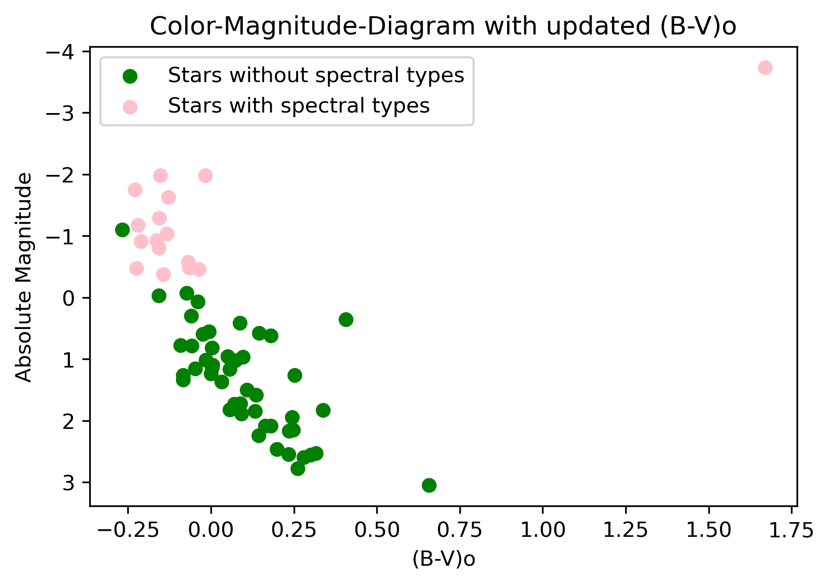

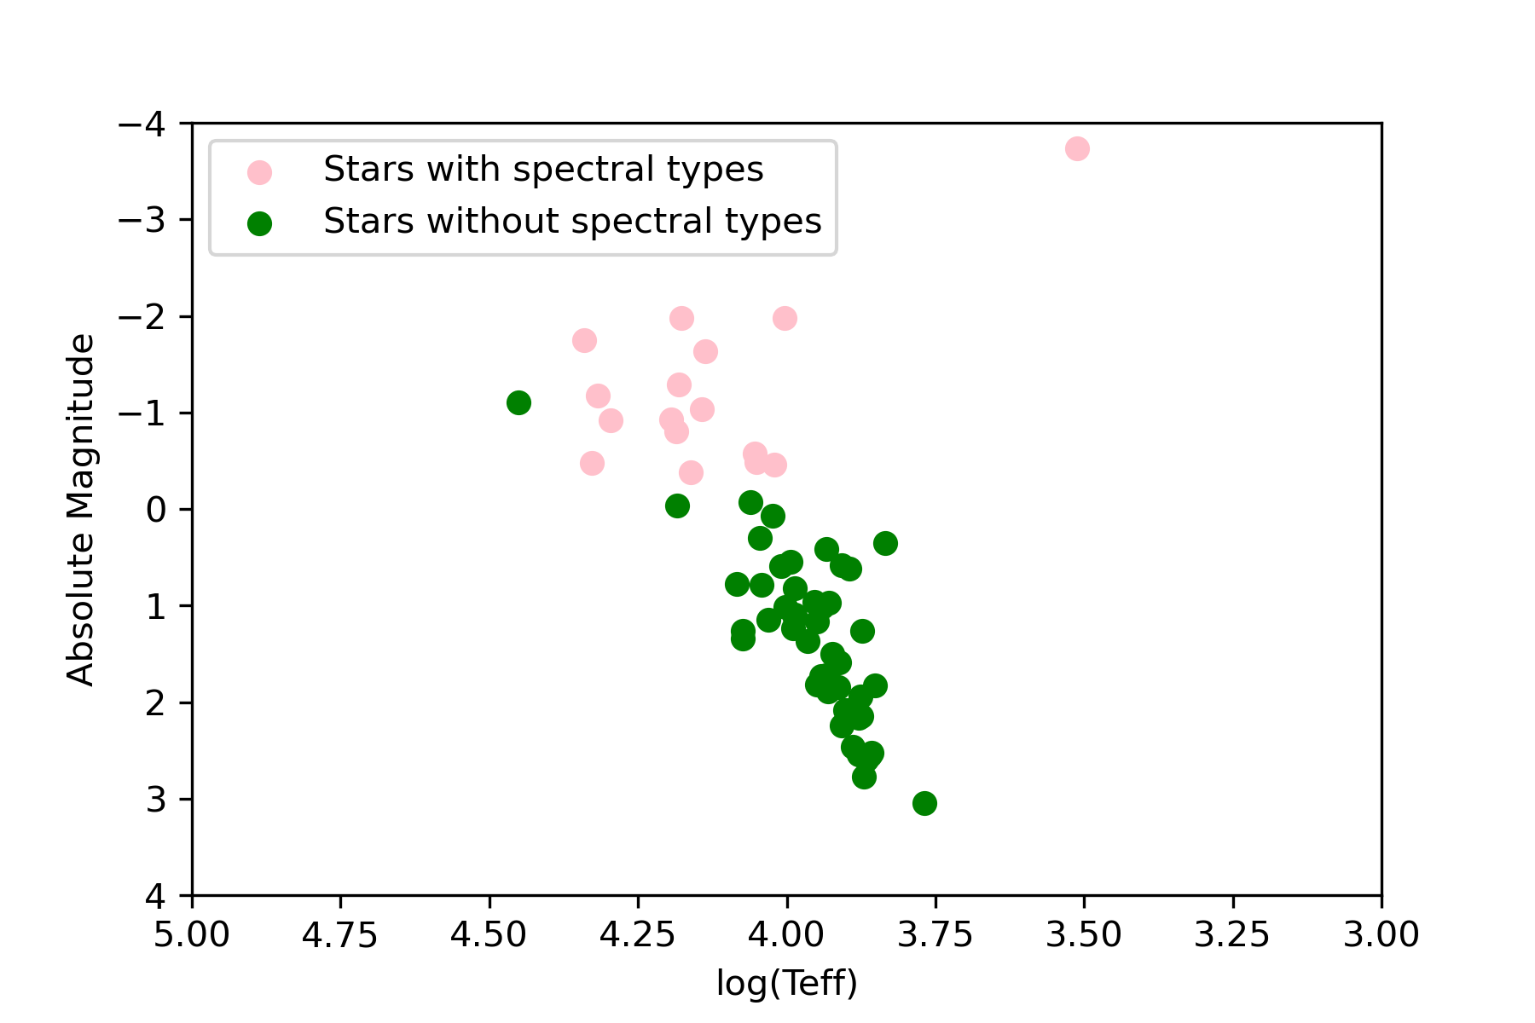
Processing the Data
Mean Average of E(B-V) = 0.9
Mean Average of the distance to the cluster = 3.79kpc (12361.33 ly)
Colors are closely tied to spectral types
Colors and Temperature are directly related

Slide 5
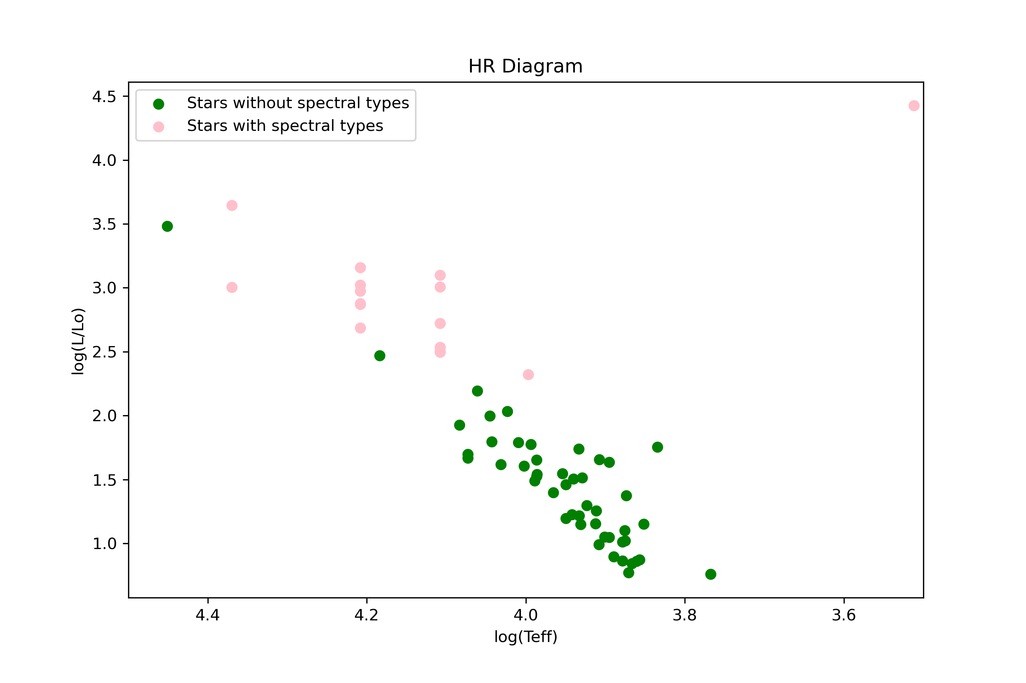
Results

Slide 6
Questions?

